Slide 1
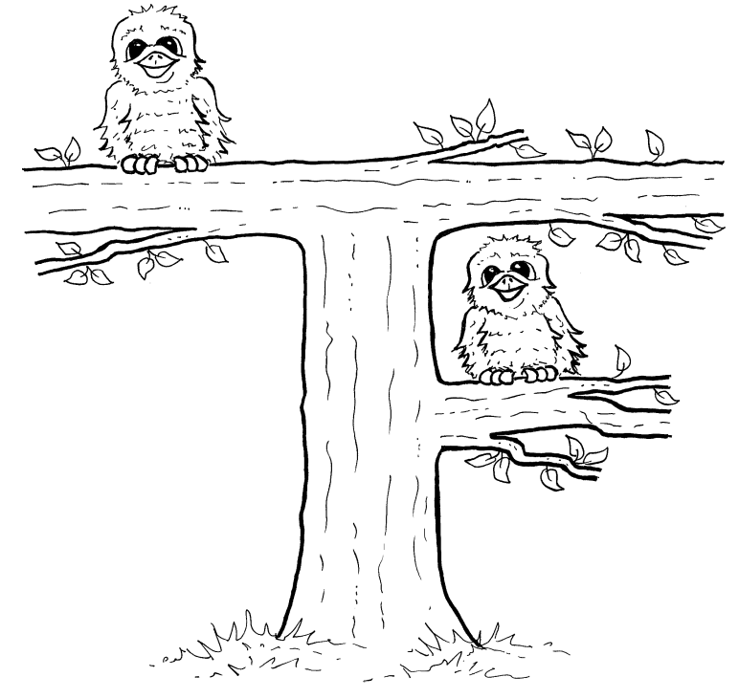
The Cheese Wedge of Doom
A Fledge Town Story

Slide 2
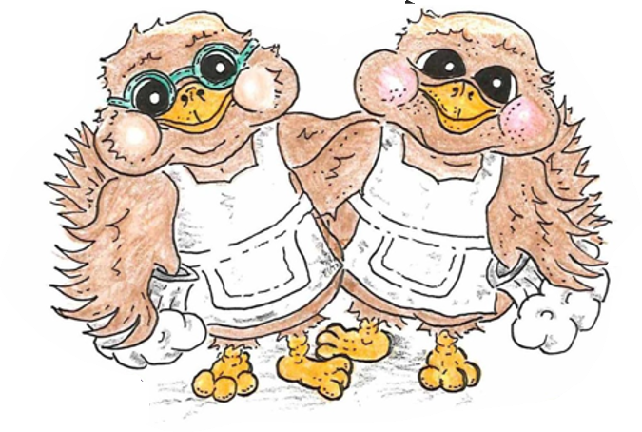
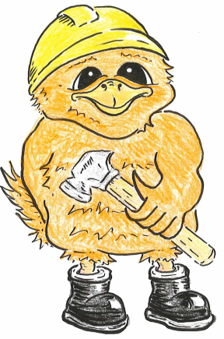
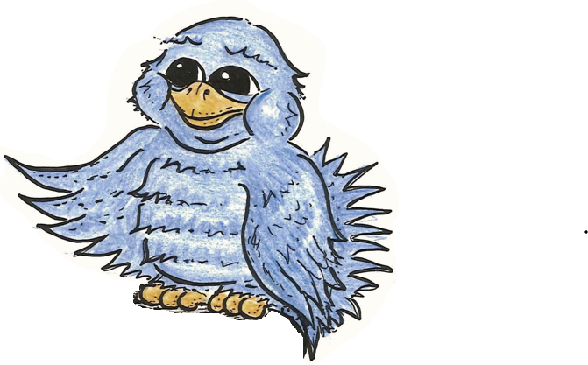
Lina Birds

Slide 3
Otto’s Motto
No plan is too big,
No job is too small,
Orange birds have the skills,
To fix them all.

Slide 4
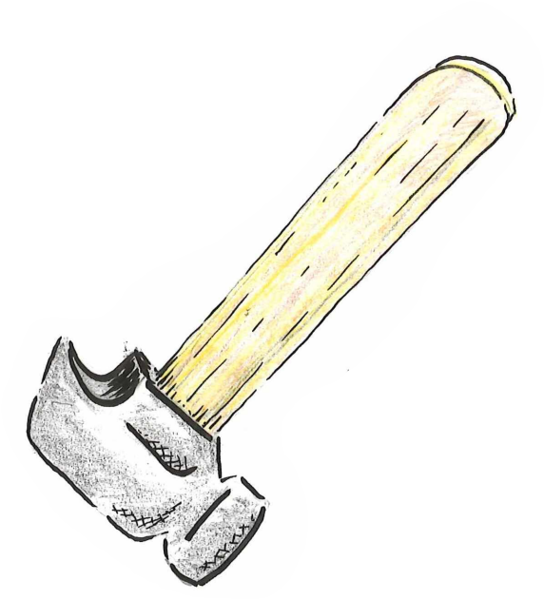
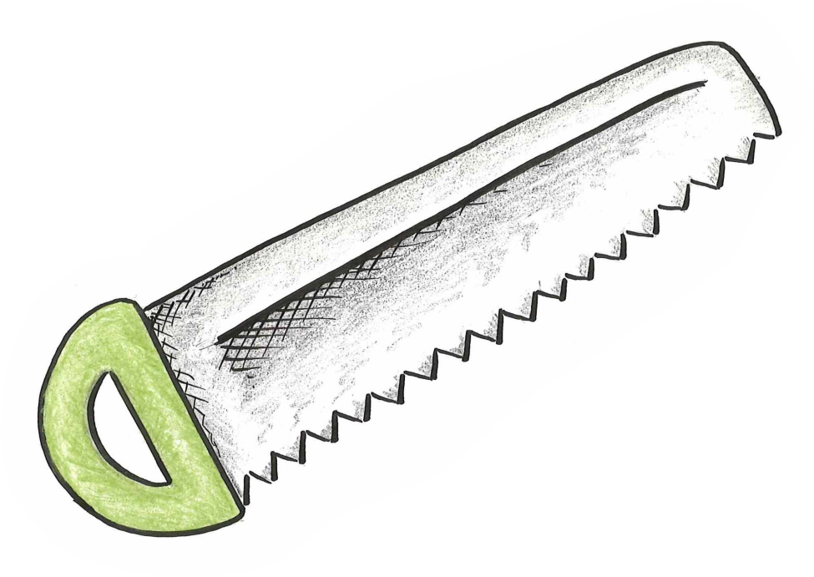
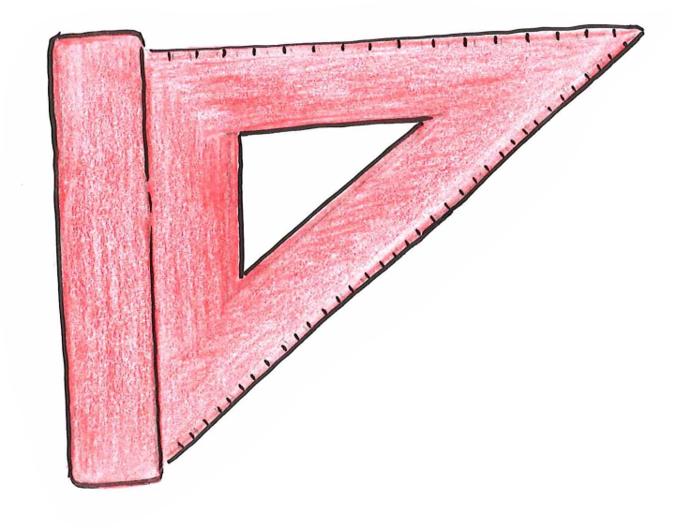

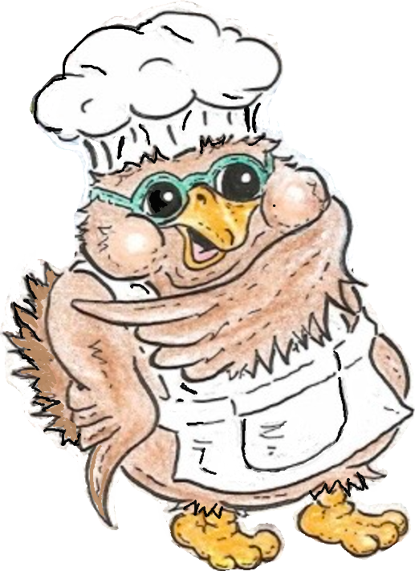
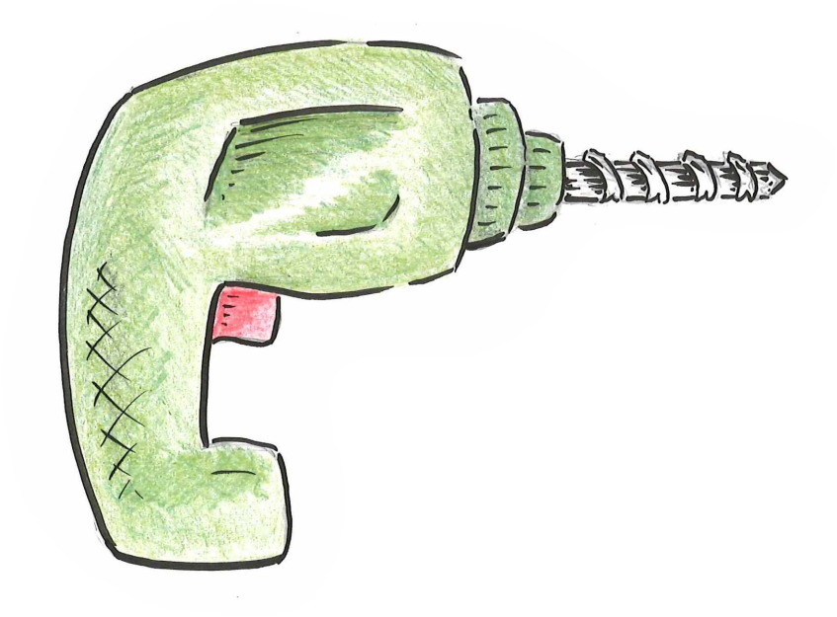

sawing
set square
What is the Order?
hammering
Bud
drilling
ice-cream

Slide 5
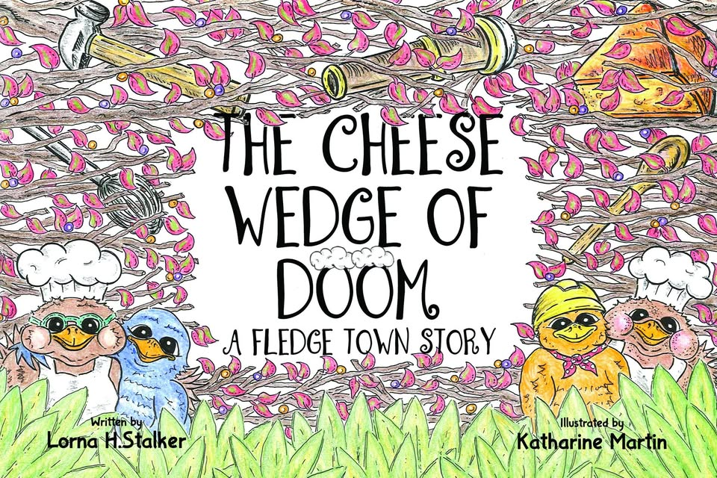

Slide 6
sawing
set square
What is the Order?
hammering
Bud
drilling
ice-cream

Slide 7
Ask Me
Question
…
Pick a number between 1 and 10.

Slide 8
Build a Crane
Challenge
Can you create the shape of crane using these?

Slide 9
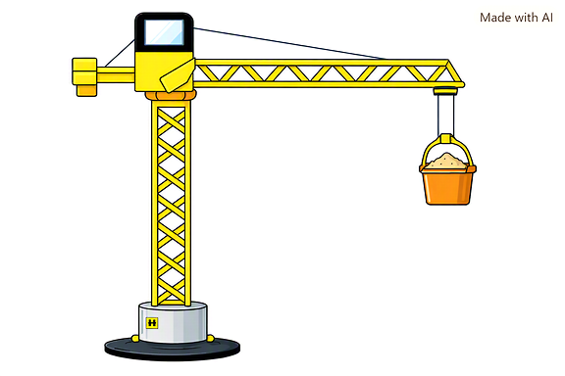
Build a Crane

Slide 10
Draw A Lina’s Den
A den is shaped like the top of your head,
Or a hill, or bridge, or a loaf of bread.
The windows like eyes, slide open and shut,
It’s all made from wood, like a garden hut,
Doors in Fledge Town are unusual in shape,
Their tops are wider like a garden gate,
They narrow a bit, nearer your feet,
Stand back and look, they’re shaped like a beak.

Slide 11
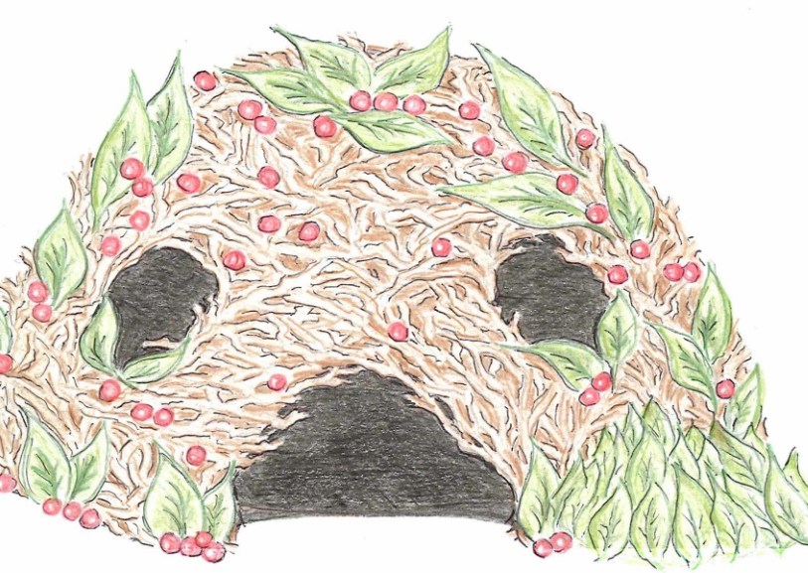
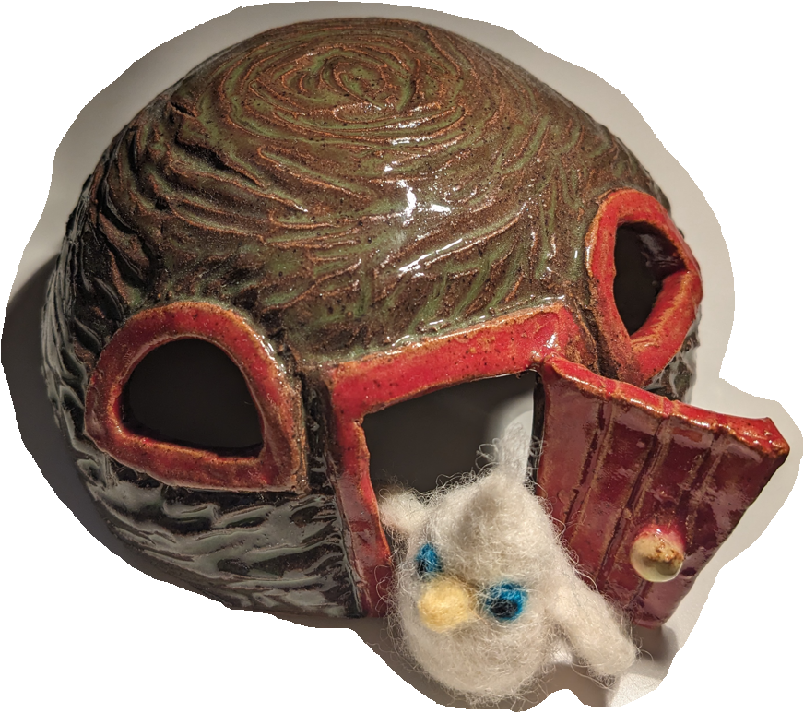
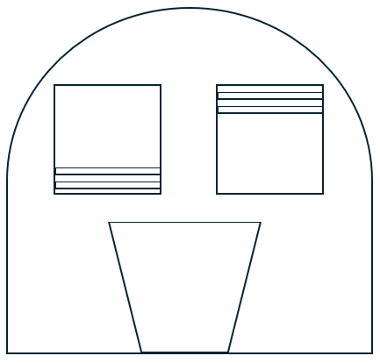
Build a 3d Lina Den
a.
Example materials – twigs, building bricks, plasticine, paper, clay, paper-mache, straws.
c.
A den is shaped like the top of your head,
Or a hill, or bridge, or a loaf of bread.
The windows like eyes, slide open and shut,
It’s all made from wood, like a garden hut,
Doors in Fledge Town are unusual in shape,
Their tops are wider like a garden gate,
They narrow a bit, nearer your feet,
Stand back and look, they’re shaped like a beak.
b.

Slide 12
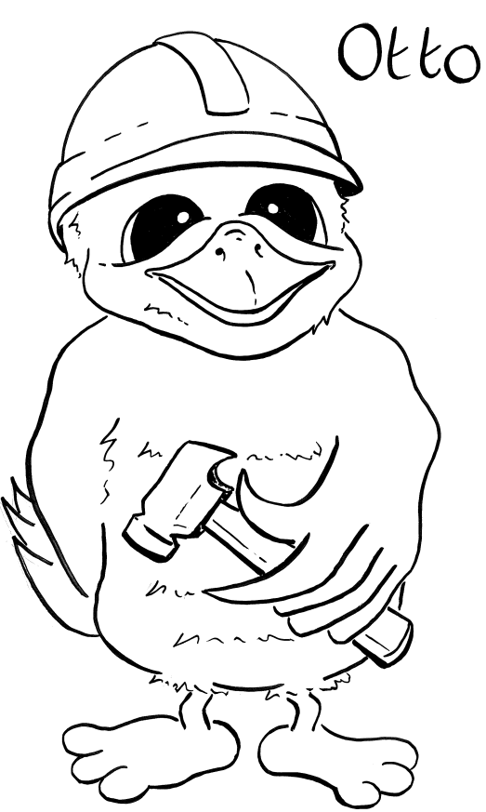








Story Title – The Cheese Wedge of Doom
 | Colour Role Tools Skills
Are you like Otto? not at all yes, a lot
Like Me?

Slide 13
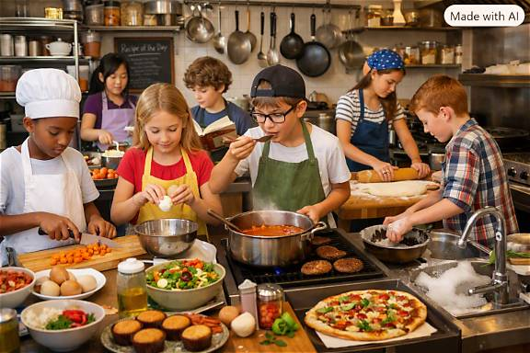
Create a list of roles found within the hospitality industry, who work with food and drink.
Working with Food & Drink

Slide 14
Baker Barista
Bar Person Butcher
Cake Decorator Chef
Chocolatier Confectioner
Cook Fish Monger
Food Scientist * Kitchen Porter
Nutritionist/Dietitian Sous Chef
Waiter/Waitress
The Food & Drink Industry
* Video describing the role of a Biotechnologist
Food and drink | My World of Work

Slide 15
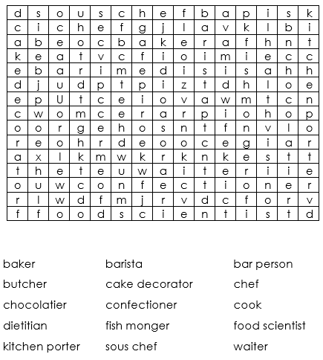
Wordsearch
The Food & Drink Industry

Slide 16
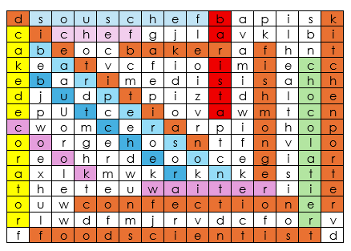
Wordsearch - Answers
The Food & Drink Industry

Slide 17
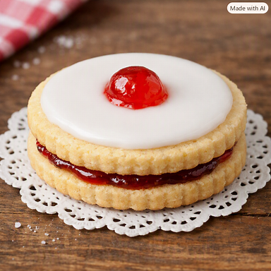
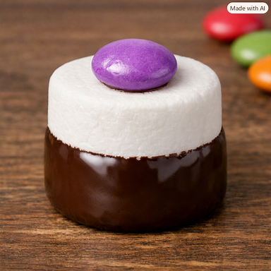
Cold Cookery

Slide 18
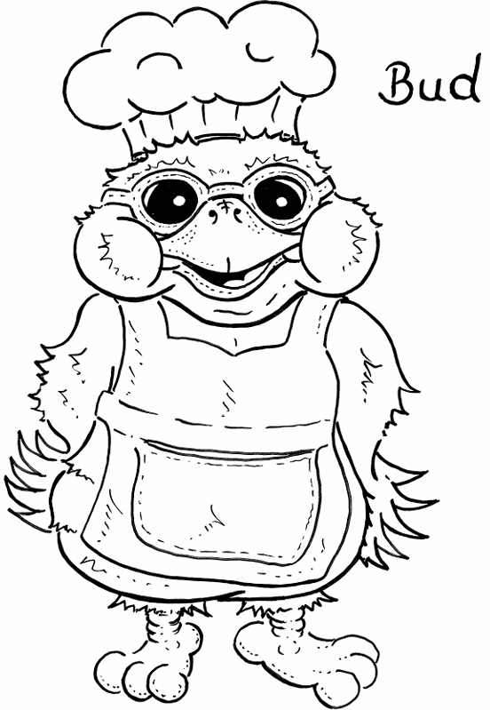
Story Title – The Cheese Wedge of Doom
 | Colour Role Tools Skills
Are you like Bud? not at all yes, a lot
Like Me?

